Slide 1
Produce Safety by Moses Momanyi, Kilimo MN February 10, 2024

Slide 2
Objectives
Define Produce Safety
Highlight importance of produce safety
Introduction to common causes and sources of produce contamination
Introduction to produce post harvest handling

Slide 3
Produce Safety
Produce Safety definition:
Produce safety refers to the practices and measures implemented to ensure that fruits and vegetables are grown, harvested, handled, and stored to prevent foodborne illness.
In 2014–2021, a total of 78 foodborne disease outbreaks linked to leafy greens (mainly lettuce) were reported to CDC.

Slide 4
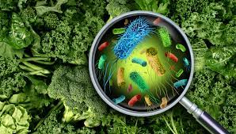
Public Health: Contaminated produce can lead to outbreaks that affect public health, causing illnesses, hospitalizations, and in severe cases, fatalities.

Slide 5
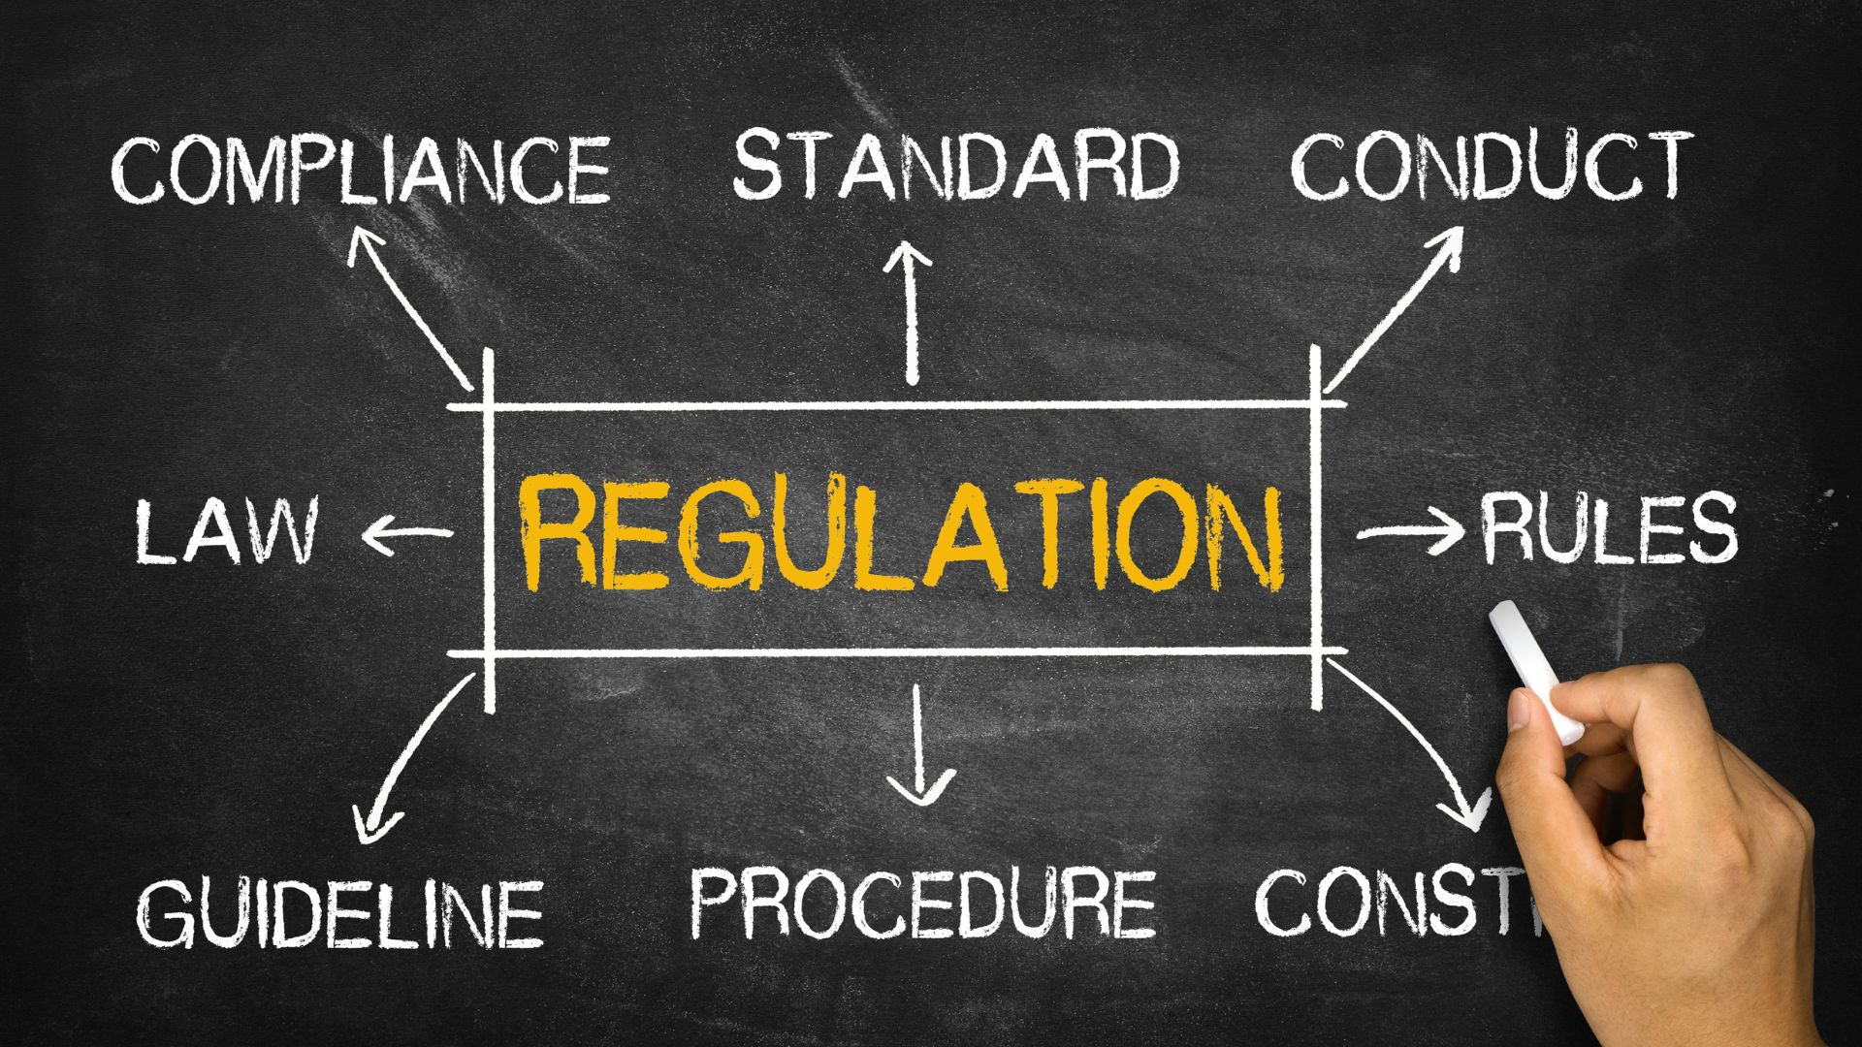
Legal Compliance: Compliance with produce safety regulations, standards, and guidelines is essential for farmers to meet legal requirements and avoid potential penalties or legal consequences
Importance of produce safety

Slide 6
Fruits, vegetables, sprouts, and mushrooms covered under the regulation are: Commercial farms with average annual produce sales of at least $25,000 calculated over the previous three years of production. Likely to be eaten raw (e.g., leafy greens, cucumbers, tomatoes, summer squash, and most fruits). Put another way, produce not covered under the regulation includes those commodities that are: Grown on farms with average annual produce sales less than $25,000 (increased each year to account for inflation). Rarely eaten raw (e.g., potatoes, winter squash, pumpkins, and some root crops). FDA has an exhaustive list of produce that is rarely consumed raw, and thus not covered under the regulation.
Importance of produce safety
Notes:
Raw produce is considered riskier than cooked fruits and vegetables where any harmful microorganisms are likely to be destroyed.

Slide 7
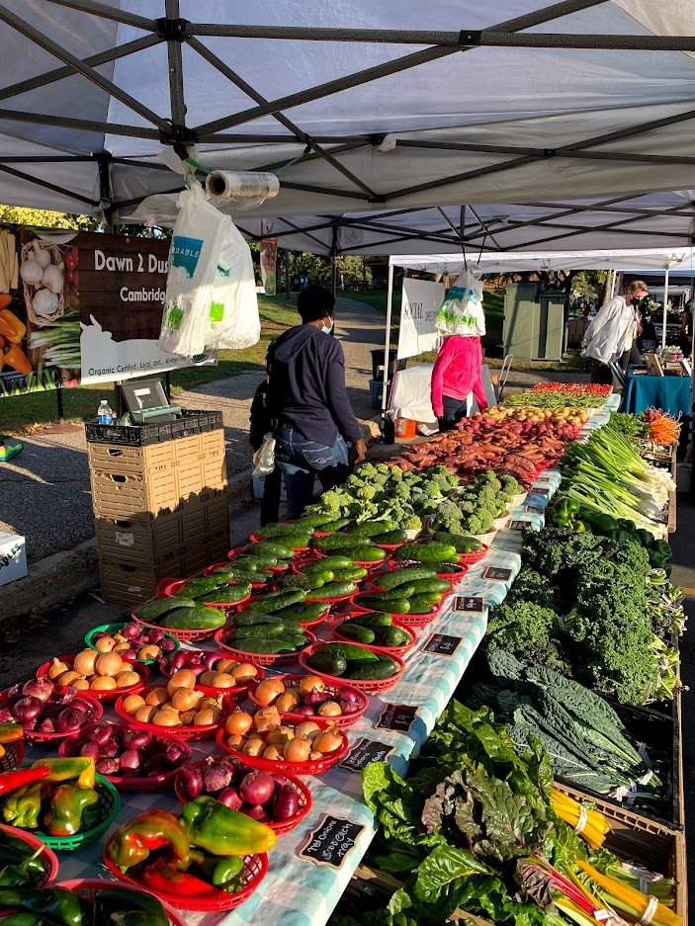
Importance of produce safety
Consumer Confidence: Safe produce practices enhance consumer trust and confidence in the food supply chain.
Notes:
What influenced changes in values - 10 min breakout (525 – 535) feedback 535- 545pm

Slide 8
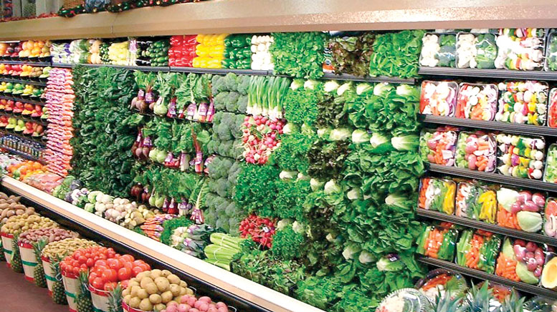
Market Access: Many retail and wholesale buyers, including grocery stores, restaurants, and food service providers, require assurance of produce safety from their suppliers.
Importance of produce safety
Notes:
Raw produce is considered riskier than cooked fruits and vegetables where any harmful microorganisms are likely to be destroyed.

Slide 9
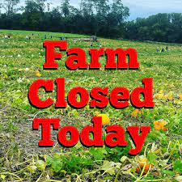
Importance of produce safety
Economic Viability: Foodborne illness outbreaks linked to produce can have devastating financial consequences for farmers, including lost sales, product recalls, litigation costs, and damage to reputation.
Notes:
Ensuring the safety of produce reduces the risk of foodborne illnesses caused by pathogens such as Salmonella, E. coli, and Listeria.
When consumers are confident that the produce they purchase is safe to eat, they are more likely to continue buying fresh fruits and vegetables, supporting both farmers and the overall agricultural industry.
. Adhering to food safety regulations demonstrates a commitment to quality and safety standards.
Compliance with food safety standards enables farmers to access lucrative markets and distribution channels, enhancing their business opportunities and profitability.
Prioritizing produce safety practices helps protect farmers' economic interests and ensures the long-term viability of their businesses.

Slide 10
Market Access: Many retail and wholesale buyers, including grocery stores, restaurants, and food service providers, require assurance of produce safety from their suppliers.
Importance of produce safety

Slide 11
Produce-related foodborne pathogens
Salmonella: Salmonella can contaminate a wide range of produce, including leafy greens, tomatoes, melons, sprouts, and herbs.
Escherichia coli (E. coli): Certain strains of E. coli, such as E. coli O157:H7, are associated with foodborne illness from contaminated produce, particularly leafy greens and sprouts.
Listeria monocytogenes: Listeria can contaminate various types of produce, including fresh-cut fruits, vegetables, and unpasteurized juices.
Norovirus: While norovirus is commonly associated with foodborne outbreaks linked to ready-to-eat foods, it can also contaminate produce, especially if handled by infected individuals.
Campylobacter: Although primarily associated with raw poultry, Campylobacter can also contaminate produce, particularly through cross-contamination.
Clostridium botulinum: While rare, Clostridium botulinum spores can contaminate certain low-acid vegetables and fruits, particularly when improperly processed or stored
Toxoplasma gondii: Toxoplasma can contaminate soil and water, leading to contamination of fruits and vegetables grown in contaminated areas

Slide 12
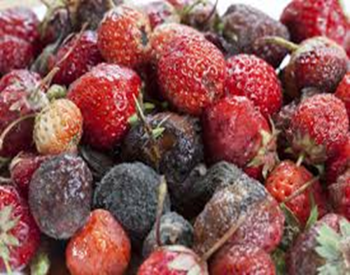
Introduction to common sources of produce contamination
Environmental Factors: Environmental conditions such as temperature, humidity, and moisture levels can influence the survival and growth of pathogens on produce. Warm and humid environments provide favorable conditions for microbial proliferation, increasing the risk of contamination.

Slide 13
Introduction to common sources of produce contamination
Environmental Contamination:
Wildlife and Pest Intrusion: Wildlife, birds, insects, and rodents can carry pathogens and contaminate produce through direct contact or fecal contamination. Pest infestations in fields, storage areas, or processing facilities can introduce contaminants to fruits and vegetables.

Slide 14
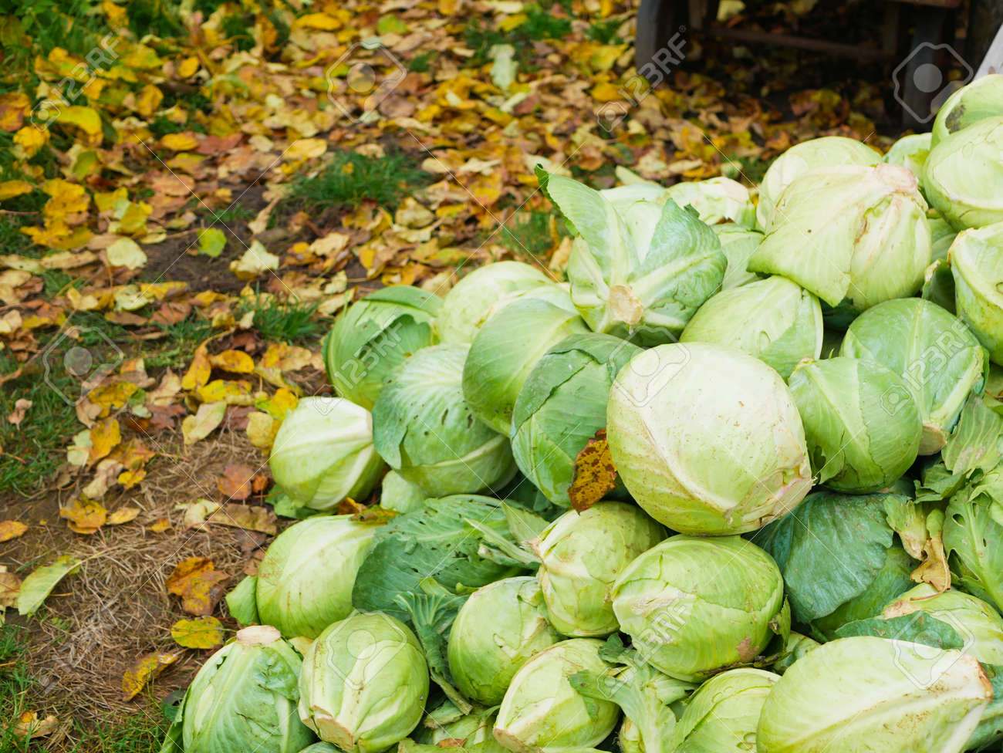
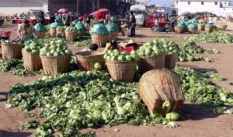
Introduction to common sources of produce contamination
Improper Handling:
Poor hygiene practices during harvesting, packing, and transportation can contribute to produce contamination. Contact with unclean surfaces, equipment, or hands contaminated with pathogens can transfer harmful microorganisms to fruits and vegetables.

Slide 15
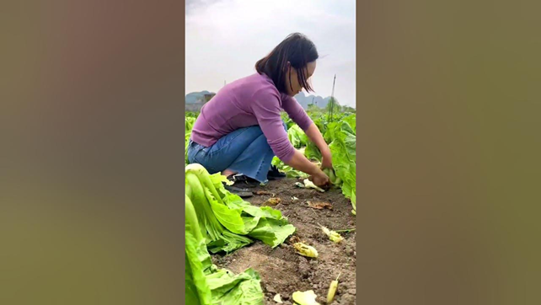
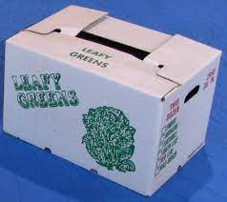
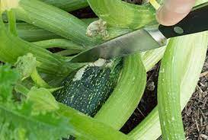
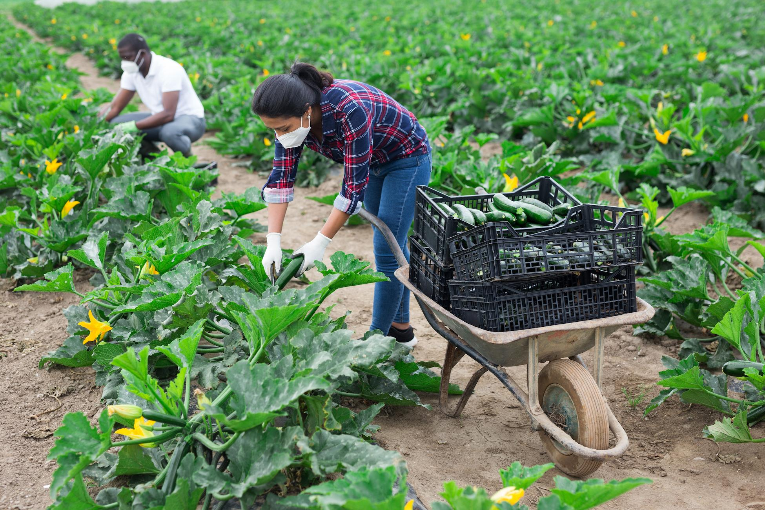
Cross-Contamination: Produce can become contaminated when it comes into contact with surfaces, tools, or equipment that have previously been in contact with pathogens. Cross-contamination can occur at various stages of production, processing, storage, and distribution.
Introduction to common sources of produce contamination

Slide 16
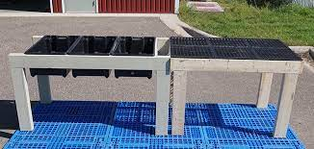
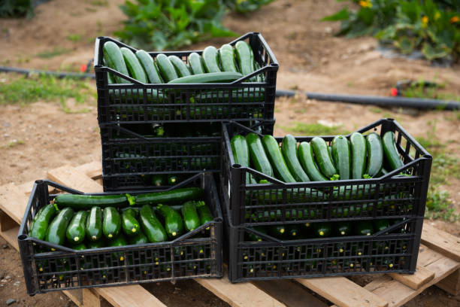
Poor Sanitation Practices: Lack of proper sanitation measures in farm facilities, packinghouses, and processing facilities can increase the risk of produce contamination. Failure to maintain clean and sanitized equipment, facilities, and personnel can contribute to the spread of pathogens. .
Introduction to common sources of produce contamination

Slide 17
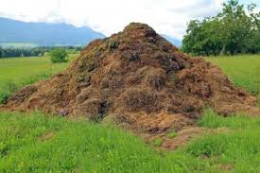
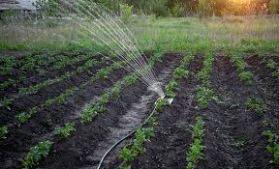
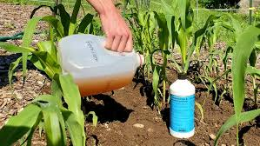
Use of Contaminated Inputs: Inputs such as irrigation water, fertilizers, manure, and pesticides can introduce pathogens to the growing environment. Contaminated inputs used during cultivation or post-harvest handling can lead to produce contamination. .
Introduction to common sources of produce contamination

Slide 18
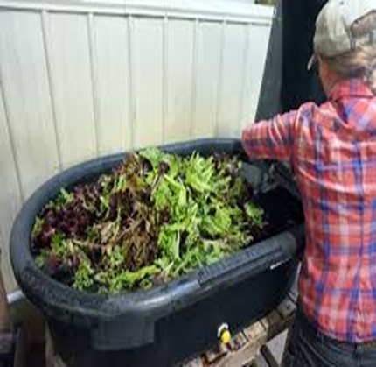
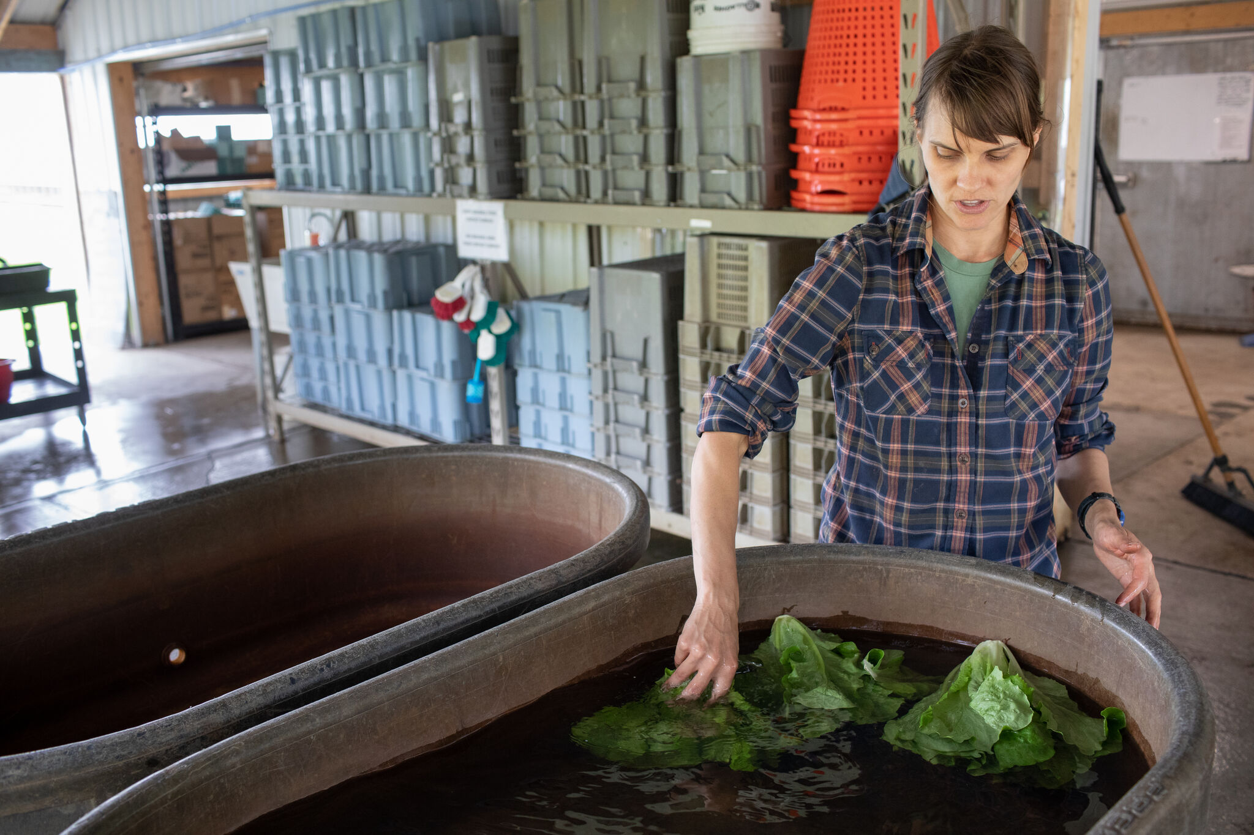
Inadequate Washing: Improper or insufficient washing of produce can fail to remove contaminants effectively. Washing with contaminated water or using ineffective cleaning methods may not eliminate pathogens present on the surface of fruits and vegetables. .
Introduction to common sources of produce contamination

Slide 19
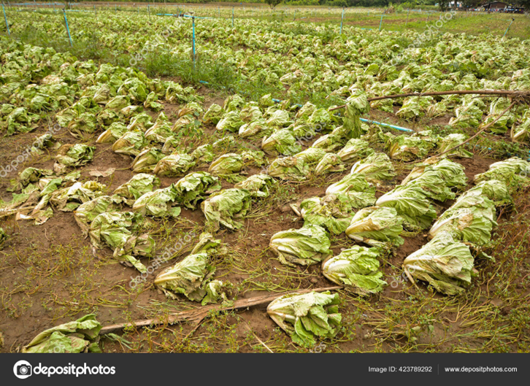
Introduction to common sources of produce contamination
Produce can become contaminated with pathogens from the soil, water, or air in the growing environment. Factors such as animal feces, wildlife intrusion, contaminated irrigation water, and airborne pathogens can introduce contaminants to crops.

Slide 20
Principles of Produce Post-Harvest Handling
Principles of produce post-harvest handling is essential for farmers, packers, distributors, and retailers alike to ensure the delivery of high-quality, safe, and nutritious fruits and vegetables to consumers around the world.
Temperature Management: Cold storage or refrigeration helps slow down physiological processes like ripening and decay.
Humidity Control: Proper humidity levels are essential to prevent dehydration or excessive moisture buildup, which can lead to wilting, mold growth, and spoilage.
Sanitation: Cleanliness is paramount in post-harvest handling to minimize the risk of contamination by pathogens or spoilage microorganisms. Regular cleaning and sanitizing of equipment, surfaces, and storage areas help maintain food safety and quality.
Gentle Handling: Produce should be handled with care to avoid bruising, crushing, or other physical damage that can accelerate deterioration. Gentle handling practices during harvesting, packing, and transportation help preserve the integrity and appearance of fruits and vegetables.
Rapid Cooling: Prompt cooling of harvested produce helps preserve quality by slowing down metabolic processes and reducing the growth of spoilage microorganisms. Quick cooling methods, such as hydrocooling or forced-air cooling, are used to lower the temperature rapidly.

Slide 21
Principles of Produce Post-Harvest Handling
Proper Packaging: Packaging plays a vital role in protecting produce from physical damage, moisture loss, and contamination during storage and transportation. Packaging materials should be suitable for the specific type of produce and provide adequate ventilation to prevent condensation and mold growth.
Quality Sorting: Sorting produce based on size, ripeness, color, and other quality attributes helps ensure uniformity and consistency in the final product. Quality control measures help identify and remove damaged, defective, or overripe fruits and vegetables.
Traceability: Tracking the movement of produce from farm to fork is essential for food safety, quality assurance, and regulatory compliance. Implementing traceability systems allows stakeholders to identify and address any issues that may arise during the supply chain.
Environmental Control: Environmental factors such as light exposure, ethylene gas, and air circulation can affect the quality and shelf life of produce. Properly managing these factors, such as storing fruits and vegetables away from direct sunlight and ethylene-producing items, helps maintain freshness and extend storage life.
Continuous Monitoring: Regular monitoring of temperature, humidity, ethylene levels, and other critical parameters allows for early detection of potential issues and timely intervention to prevent quality deterioration or spoilage. Monitoring systems provide valuable data for optimizing post-harvest handling practices and improving overall efficiency.

Slide 22
Questions
Comments

