Slide 1


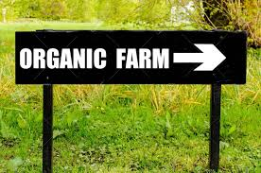
Organic Farming by Moses Momanyi, Kilimo MN
February 15, 2024

Slide 2

Objectives
Principles of Organic farming
Highlight Key Elements of Organic Farming

Slide 3
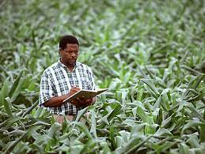
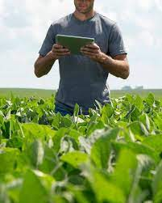

Organic Farming
Principles of Organic farming:
Transparency and Integrity: Maintain detailed records, undergo regular inspections, and ensure transparency in farming practices to uphold the integrity of the organic label.

Slide 4

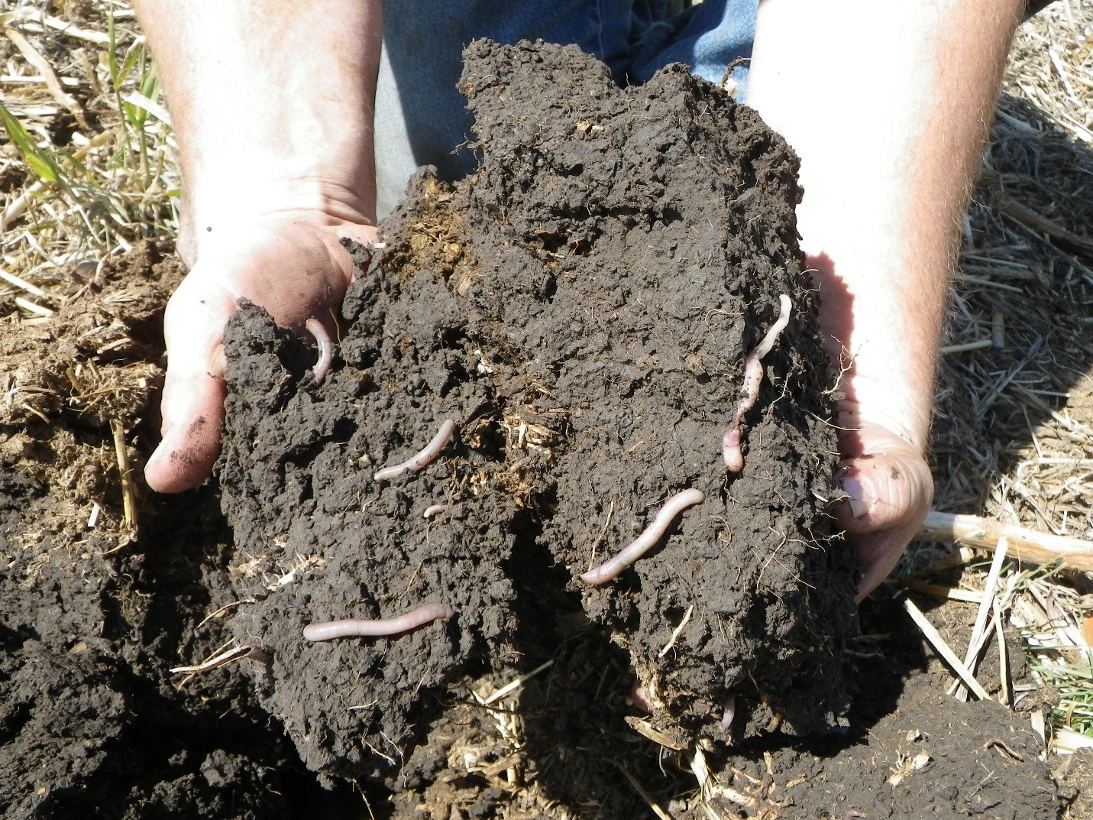
Soil Health: Build and maintain healthy soil through practices such as composting, crop rotation, and minimal soil disturbance. Healthy soil is essential for nutrient cycling, water retention, and plant growth.
Principles of Organic farming:

Slide 5
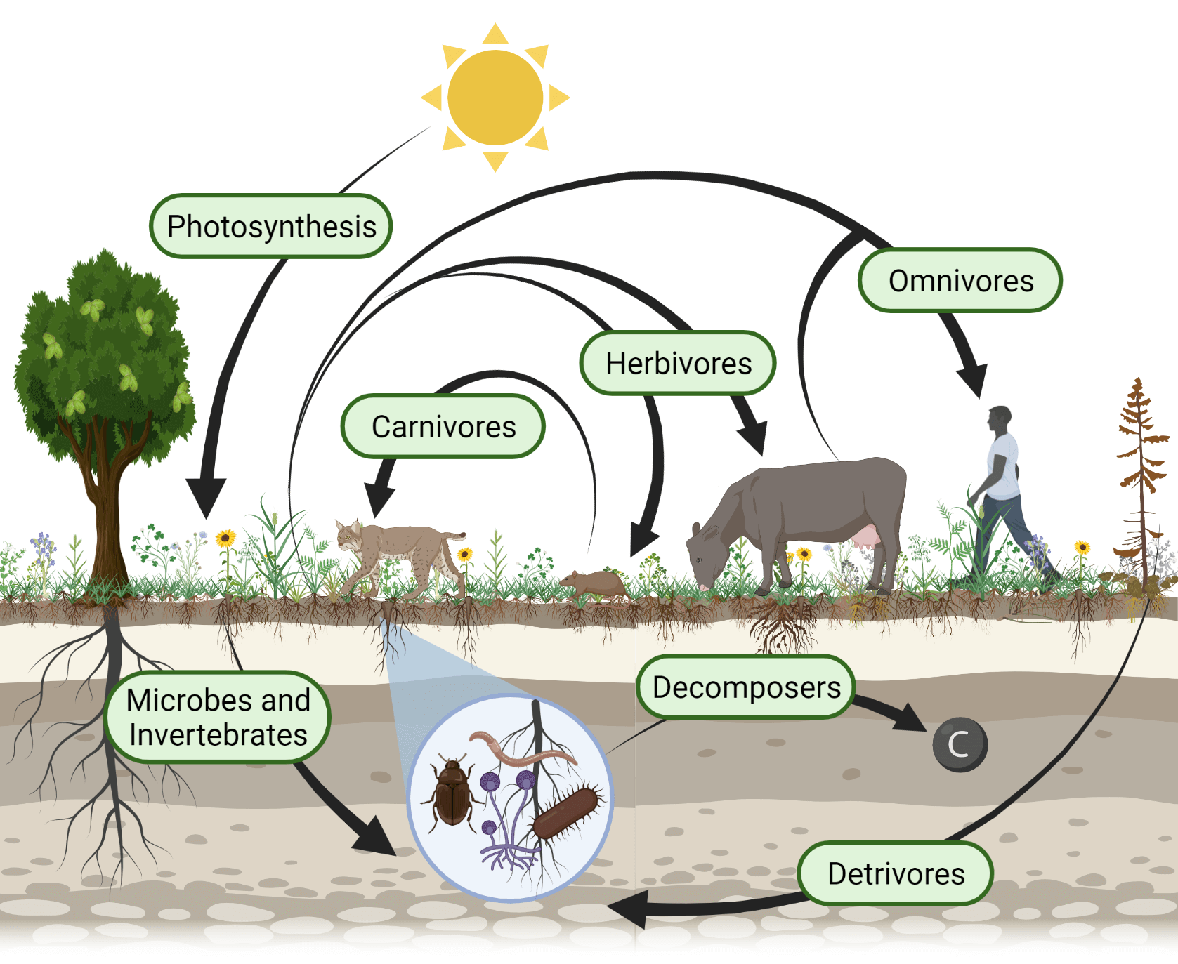
Ecological Balance: Mimic natural ecosystems and promote harmony between plants, animals, and the environment. This involves minimizing external inputs, conserving resources, and fostering ecological processes.
Principles of Organic farming:

Slide 6
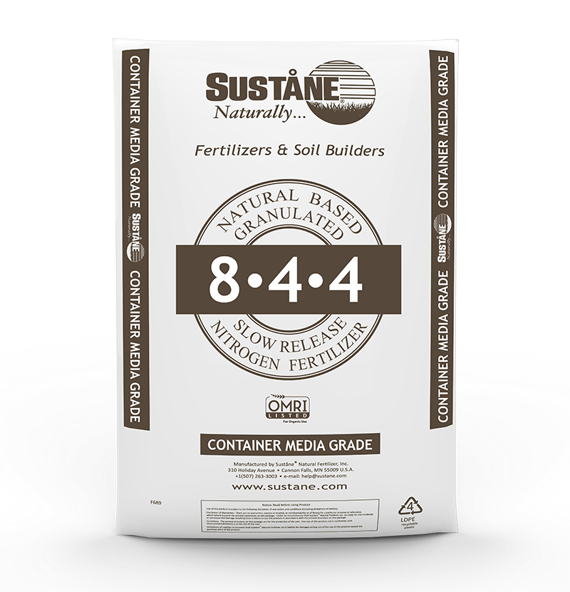
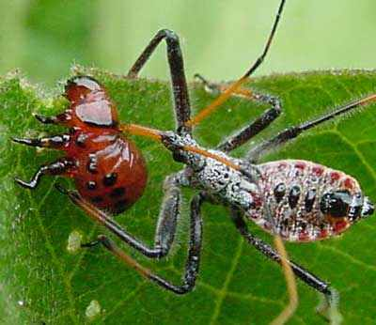
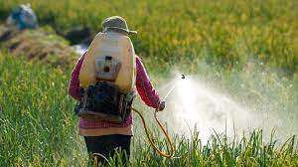
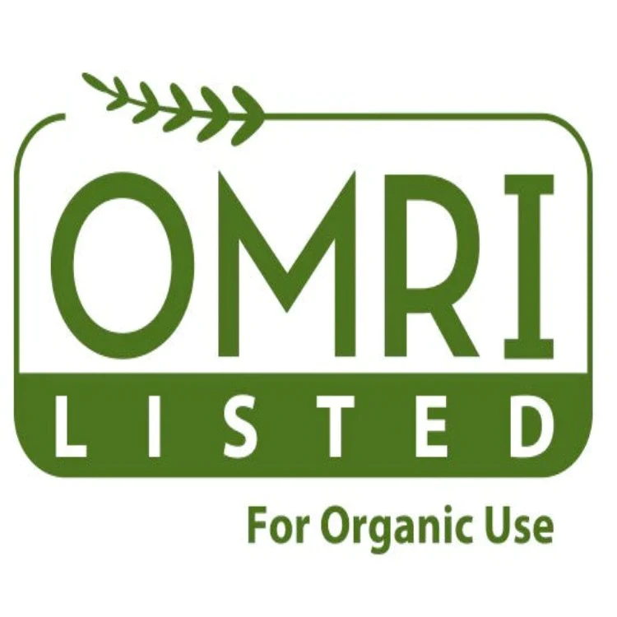
Use of Organic Inputs: Avoid synthetic pesticides, herbicides, fertilizers, and genetically modified organisms (GMOs). Instead, rely on organic inputs such as compost, cover crops, and natural pest control methods to nourish crops and manage pests
Principles of Organic farming:
Avoid synthetic pesticides

Slide 7
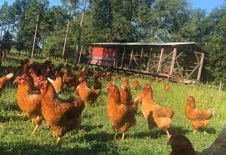
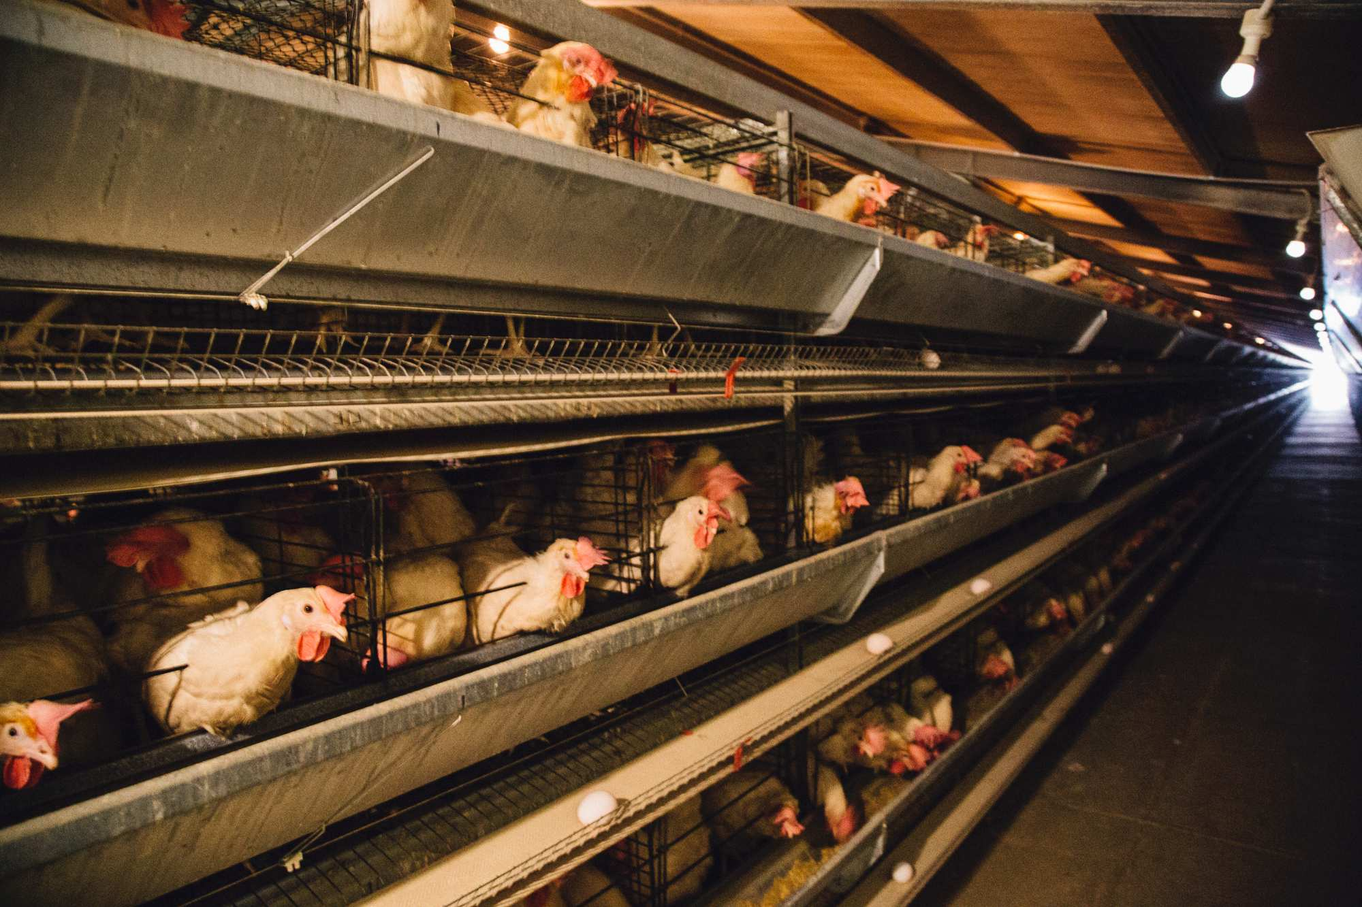
Animal Welfare: Prioritizes the well-being of animals by providing access to outdoor pasture, nutritious feed, and humane living conditions. Animals are raised without the use of growth hormones or antibiotics, and their natural behaviors are respected.
Principles of Organic farming:

Slide 8
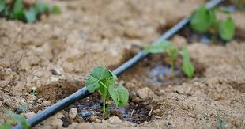
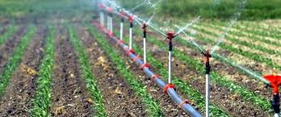
Sustainability: Practices are sustainable over the long term, preserving natural resources, reducing environmental impact, and supporting the needs of future generations. This includes conserving water, reducing energy consumption, and promoting renewable energy sources.
Principles of Organic farming:

Slide 9
Questions ?
Comments?
Principles of Organic farming:

Slide 10
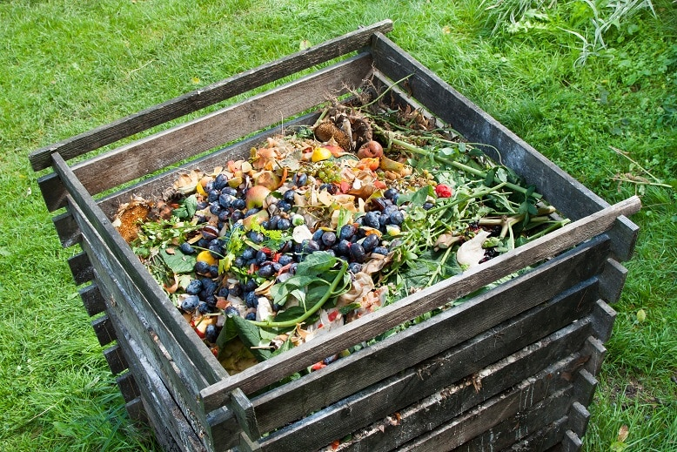
Soil Management through Composting: Plants and Kitchen waste
Nutrient Content: Compost contains essential plant nutrients such as nitrogen, phosphorus, potassium, as well as micronutrients like calcium, magnesium, and sulfur. These nutrients are released slowly over time, providing a steady supply of nutrition to plants.
Soil Improvement: Compost improves soil structure by enhancing its texture, aeration, and water retention capacity.
Organic Matter: Compost adds organic matter to the soil, which serves as a food source for soil organisms This biological activity helps break down soil pollutants, suppresses diseases, and improves soil fertility and ecosystem health. pH Balance: Compost has a near-neutral pH, which helps balance soil acidity and alkalinity. It buffers pH fluctuations, making soils more resilient to changes and providing an optimal environment for plant root growth and nutrient uptake.
Weed and Pest Control: Compost can suppress weed growth by smothering weed seeds and preventing their germination. It also contains beneficial microorganisms and compounds that can suppress certain plant diseases and pests, reducing the need for chemical interventions.
Environmental Benefits: Using organic compost helps divert organic waste from landfills and promotes sustainable agriculture practices by reducing reliance on synthetic fertilizers and chemical inputs.
Elements of Organic farming:
Notes:
Organic farming encompasses a range of practices and techniques aimed at cultivating crops and raising livestock in harmony with nature while minimizing synthetic inputs and environmental impact. Here are the key elements of organic farming

Slide 11
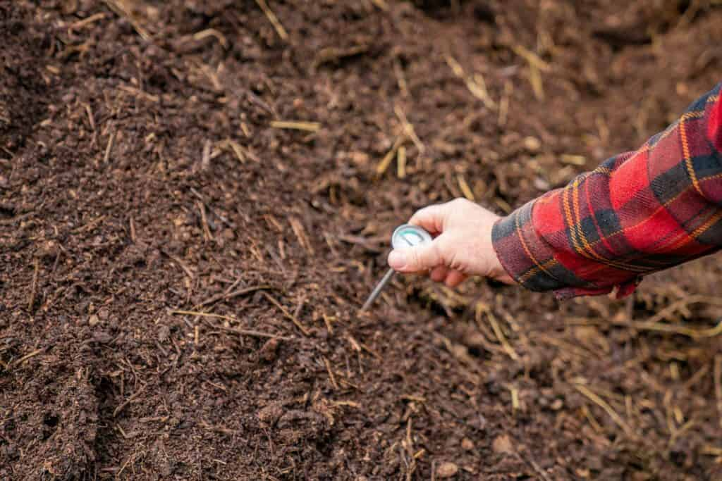
Soil Management through Animal Manure Composting:
Proper composting reduces pathogens, eliminates odor, and creates a valuable product for use in gardening and agriculture.
Here's an overview of the animal manure composting process:
1. Collect fresh animal manure from livestock such as cows, horses, pigs, chickens, or sheep.
2. Combine the manure with a carbon-rich material such as straw, hay, sawdust, leaves, or shredded paper. The carbon source provides structure to the compost pile, absorbs excess moisture, and balances the nitrogen content of the manure.
3. Alternate layers of manure and carbon material in the compost pile or bin. Aim for a balanced ratio of approximately two parts carbon to one part manure by volume. Ensure each layer is adequately moistened but not overly wet. Regularly turn or aerate the compost pile to provide oxygen to the microorganisms responsible for decomposition. Turning the pile every few days to weeks helps accelerate the composting process and ensures even decomposition. Monitor the moisture content of the compost pile to maintain optimal conditions for microbial activity. The compost should feel like a damp sponge, with moisture evenly distributed throughout the pile.
4. Composting generates heat as microorganisms break down organic matter. Monitor the internal temperature of the compost pile using a compost thermometer. The ideal temperature range for composting is between 120°F and 160°F (49°C to 71°C). Higher temperatures help kill weed seeds and pathogens.
5. Allow the compost pile to mature for several weeks to several months, depending on factors such as temperature, moisture, and the size of the pile resulting in a dark, crumbly compost with an earthy smell. After the composting process is complete, let the compost cure or age for an additional few weeks to several months. Curing allows any remaining pathogens to die off and ensures a stable, mature compost product ready for use in gardens, landscaping, or agricultural fields.
Elements of Organic farming:
Notes:
Organic farming encompasses a range of practices and techniques aimed at cultivating crops and raising livestock in harmony with nature while minimizing synthetic inputs and environmental impact. Here are the key elements of organic farming

Slide 12
These cover crops are grown primarily to protect and improve the soil rather than for harvest. They can also be a source of cash
Here are the key aspects of cover cropping:
Soil Health: Their extensive root systems help prevent soil erosion by holding the soil in place. Add organic matter to the soil as they decompose, improving soil structure, fertility, and moisture retention.
Weed Suppression: Cover crops can suppress weed growth by outcompeting weeds for sunlight, water, and nutrients. By reducing weed pressure, cover crops help farmers minimize the need for herbicides and manual weed control, promoting more sustainable weed management practices.
Nutrient Management: Certain cover crops, such as legumes like clover and vetch, have the ability to fix atmospheric nitrogen through symbiotic relationships with nitrogen-fixing bacteria. When these legume cover crops are incorporated into the soil, they release nitrogen, making it available for subsequent cash crops. This reduces the need for synthetic nitrogen fertilizers and promotes more efficient nutrient cycling in agricultural systems.
Pest Control: Cover crops can provide habitat and food sources for beneficial insects, including pollinators and natural enemies of crop pests. By increasing biodiversity on the farm, cover crops help support populations of beneficial organisms that contribute to pest control, reducing reliance on chemical pesticides and promoting ecological balance.
Season Extension: In addition to their soil-building benefits, cover crops can also be used to extend the growing season and maximize land use efficiency. Farmers can plant cover crops during fallow periods or between cash crop plantings to keep the soil covered and productive year-round. This continuous cover helps prevent soil degradation and promotes sustainable land stewardship.
Elements of Organic farming:
Soil Management through Cover cropping:
Notes:
Organic farming encompasses a range of practices and techniques aimed at cultivating crops and raising livestock in harmony with nature while minimizing synthetic inputs and environmental impact. Here are the key elements of organic farming

Slide 13
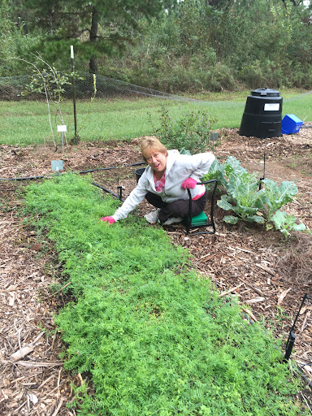
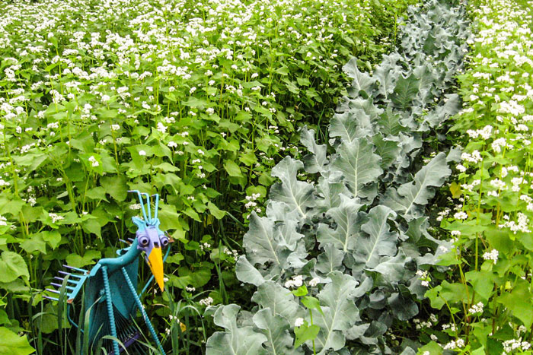
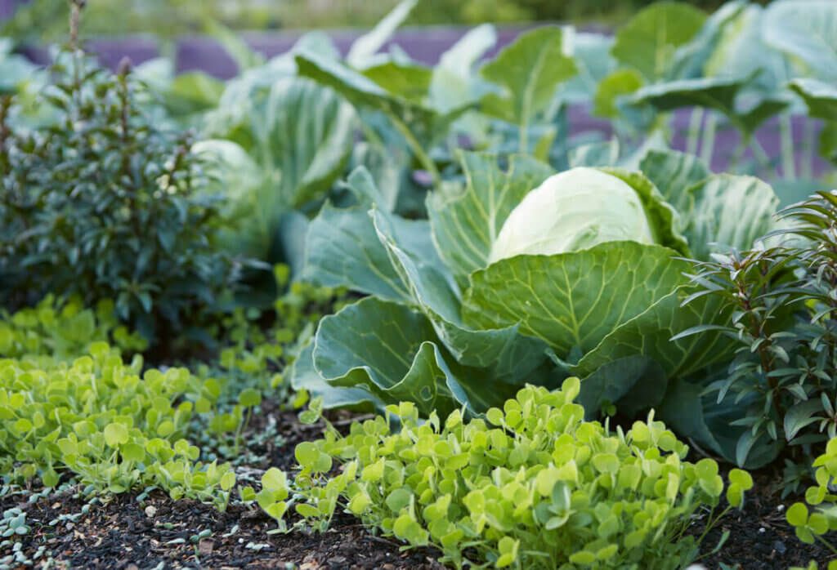
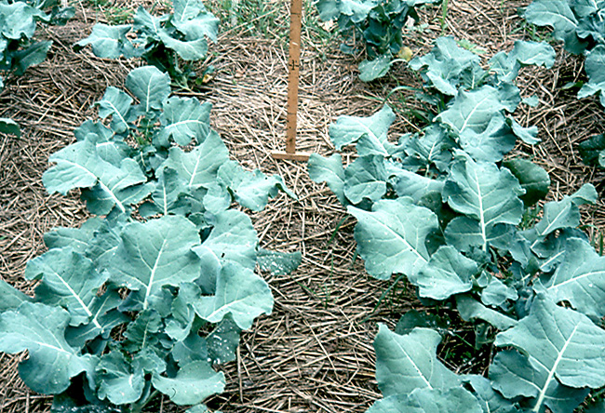
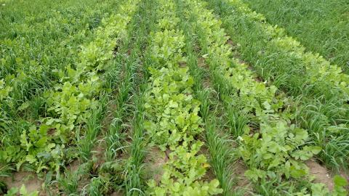
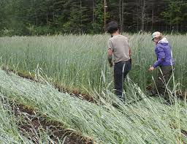
Soil Management through Cover cropping:
Elements of Organic farming:
Notes:
Organic farming encompasses a range of practices and techniques aimed at cultivating crops and raising livestock in harmony with nature while minimizing synthetic inputs and environmental impact. Here are the key elements of organic farming

Slide 14
Water Management:
Elements of Organic farming:
Water management in agriculture refers to the planning, distribution, and efficient use of water resources to sustainably meet the needs of crops while minimizing waste and environmental impact. Here are key aspects of water management in agriculture:
Irrigation Systems: Implementing efficient irrigation systems is essential for delivering water to crops in a controlled manner. Different irrigation methods, such as drip irrigation, sprinkler irrigation, and flood irrigation, can be used based on factors like crop type, soil type, climate, and water availability. Ensure that water is applied evenly and efficiently to maximize crop yields while minimizing water loss through runoff, evaporation, and deep percolation.
Water Conservation: Water conservation practices aim to reduce water waste and optimize water use efficiency in agricultural production. Techniques such as soil moisture monitoring, mulching, and precision irrigation scheduling help farmers better manage water resources by matching irrigation schedules to crop water requirements and minimizing unnecessary water applications. Use water-saving technologies like soil moisture sensors, weather-based irrigation controllers, and low-pressure irrigation systems.
Soil Health: Healthy soil plays a critical role in water management by enhancing water infiltration, retention, and drainage. Practices such as cover cropping, crop rotation, and reduced tillage help improve soil structure, increase organic matter content, and reduce soil compaction, allowing soil to better absorb and store water. Healthy soil with improved water-holding capacity reduces the frequency and volume of irrigation needed to sustain crops, contributing to more efficient water use in agriculture.
Water Quality: Managing water quality is essential for protecting both agricultural productivity and environmental health. Practices such as nutrient management, integrated pest management, and erosion control help minimize agricultural runoff and reduce the risk of water contamination by agricultural pollutants such as pesticides, fertilizers, and sediment. Maintaining water quality through responsible agricultural practices is vital for safeguarding freshwater resources and ensuring the long-term sustainability of agriculture.
Sustainable Water Use: Adopting sustainable water use practices is critical for balancing agricultural water needs with the conservation and preservation of water resources for future generations. Sustainable water management approaches focus on optimizing water use efficiency, promoting water recycling and reuse, restoring degraded water ecosystems, and enhancing water governance and policy frameworks. By prioritizing sustainability, farmers can mitigate the impacts of water scarcity, climate change, and competing water demands while maintaining productive and resilient agricultural systems.
Notes:
Organic farming encompasses a range of practices and techniques aimed at cultivating crops and raising livestock in harmony with nature while minimizing synthetic inputs and environmental impact. Here are the key elements of organic farming

Slide 15
Pest and Disease Management:
Elements of Organic farming:
Integrated Pest Management (IPM) is a holistic approach to managing pests in agriculture that focuses on preventing pest damage while minimizing risks to human health and the environment. Here are key elements of integrated pest management:
Pest Monitoring and Identification: Regular monitoring of pest populations helps farmers identify the types of pests present, their population levels, and the extent of damage they cause. Accurate pest identification is crucial for implementing appropriate control measures and making informed pest management decisions.
Cultural Practices: Cultural practices involve modifying agricultural practices to create unfavorable conditions for pests and promote natural pest control mechanisms. Examples include crop rotation, planting resistant crop varieties, adjusting planting dates to avoid peak pest activity, and optimizing irrigation and fertilization practices to promote plant health and resilience.
Biological Control: Biological control involves the use of natural enemies, such as predators, parasitoids, and pathogens, to suppress pest populations. Beneficial organisms can be introduced into the agroecosystem or conserved through habitat management practices to enhance their effectiveness in controlling pests. Biological control agents help maintain pest populations at manageable levels without the need for chemical pesticides.
Mechanical and Physical Controls: Mechanical and physical controls involve the use of physical barriers, traps, mulches, and mechanical devices to prevent pests from accessing crops or to physically remove pests from the environment. These non-chemical methods are often used in combination with other pest management tactics to reduce pest damage and limit pesticide use.
Chemical Controls: Chemical controls, such as pesticides, are used as a last resort in IPM and are selected and applied judiciously based on careful assessment of pest pressure, economic thresholds, and environmental considerations. Integrated pest management emphasizes the use of reduced-risk pesticides, selective insecticides, and targeted application methods to minimize harm to non-target organisms and reduce pesticide residues in the environment.
Monitoring and Evaluation: Continuous monitoring and evaluation of pest management practices are essential for assessing their effectiveness, identifying emerging pest issues, and making adjustments to management strategies as needed. Monitoring also helps farmers track changes in pest populations over time and evaluate the impact of IPM practices on crop health, productivity, and sustainability.
Notes:
Organic farming encompasses a range of practices and techniques aimed at cultivating crops and raising livestock in harmony with nature while minimizing synthetic inputs and environmental impact. Here are the key elements of organic farming

Slide 16
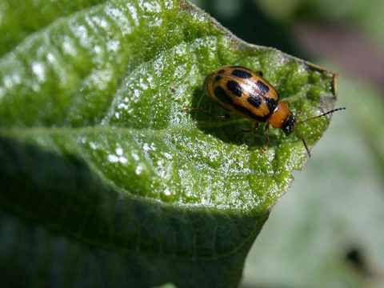
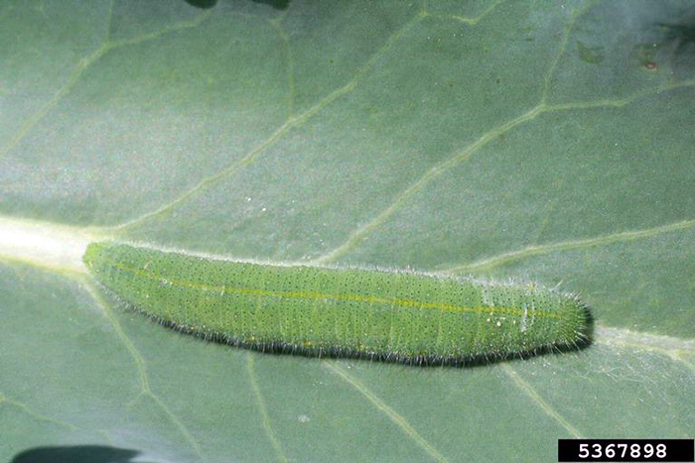
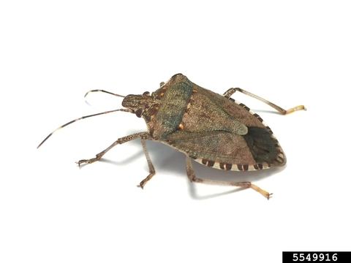
Pest and Disease Management:
Elements of Organic farming:
Pest Monitoring and Identification: Regular monitoring of pest populations helps farmers identify the types of pests present, their population levels, and the extent of damage they cause. Accurate pest identification is crucial for implementing appropriate control measures and making informed pest management decisions.
Notes:
Organic farming encompasses a range of practices and techniques aimed at cultivating crops and raising livestock in harmony with nature while minimizing synthetic inputs and environmental impact. Here are the key elements of organic farming

Slide 17
Nutrient Management:
Elements of Organic farming:
Nutrient management is a critical aspect of sustainable agriculture aimed at maximizing soil fertility and crop productivity while minimizing environmental impacts. Here's how nutrient management practices contribute to sustainable farming:
Balancing Inputs and Outputs: Nutrient management involves carefully balancing
The inputs in the farming system such as organic fertilizers, mineral fertilizers, atmospheric deposition, and biological nitrogen fixation
The outputs such as nutrient losses through leaching, erosion, volatilization, and crop uptake.
Nutrient Cycling: Sustainable nutrient management can involve cover cropping, crop rotation, and mulching. These are examples of practices that enhance nutrient cycling by returning organic matter to the soil and reducing nutrient losses.
Organic Fertilizers: Organic fertilizers, including compost, manure, and green manure, are valuable sources of nutrients for sustainable farming. These materials provide not only essential nutrients but also organic matter, which improves soil structure, water retention, and microbial activity. By incorporating organic fertilizers into soil management practices, farmers can enhance soil fertility, reduce reliance on synthetic fertilizers, and promote long-term soil health.
Soil and Plant Health Monitoring: Monitoring soil and plant health is essential for effective nutrient management. Soil testing helps farmers assess soil nutrient levels and pH, allowing them to adjust fertilizer applications accordingly. Plant tissue analysis can also provide valuable insights into nutrient deficiencies or imbalances, enabling targeted nutrient supplementation through foliar sprays or soil amendments.
Environmental Stewardship: Sustainable nutrient management practices prioritize environmental stewardship by minimizing nutrient runoff, leaching, and greenhouse gas emissions. By adopting practices that promote nutrient retention and reduce nutrient losses to water bodies and the atmosphere, farmers can protect water quality, mitigate nutrient pollution, and contribute to ecosystem health.
Notes:
Organic farming encompasses a range of practices and techniques aimed at cultivating crops and raising livestock in harmony with nature while minimizing synthetic inputs and environmental impact. Here are the key elements of organic farming

Slide 18
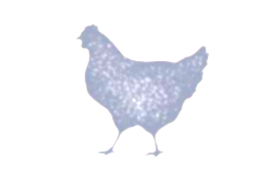
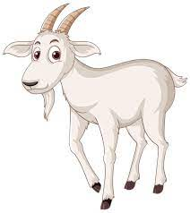
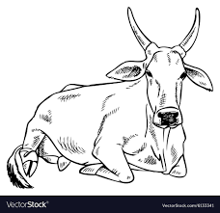
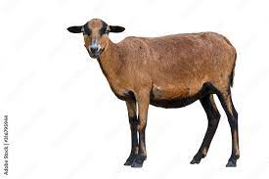
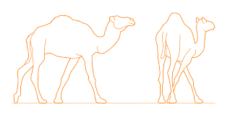
Livestock Management:
Elements of Organic farming:
Incorporating livestock into farming systems offers several benefits and opportunities for sustainable agriculture:
Nutrient Cycling: Livestock play a key role in nutrient cycling by converting crop residues, cover crops, and other organic materials into valuable manure. This organic matter is rich in nutrients such as nitrogen, phosphorus, and potassium, which can be returned to the soil to enhance soil fertility and improve crop yields. By integrating livestock into crop rotations or grazing systems, farmers can effectively recycle nutrients, reduce the need for synthetic fertilizers, and improve soil health.
Diversification: Integrating livestock diversifies farming operations, offering additional sources of income and resilience against market fluctuations. Livestock products such as meat, milk, eggs, and wool can provide supplemental revenue streams for farmers, helping to spread risk and increase overall profitability. Diversification also enhances the ecological resilience of farming systems by reducing dependence on a single commodity and promoting biodiversity.
Grazing Management: Managed grazing systems can benefit both livestock and the environment by optimizing forage utilization, improving soil health, and enhancing ecosystem services. Rotational grazing, intensive grazing, and mob grazing techniques involve moving livestock through paddocks or pastures in a controlled manner, allowing forage plants to recover and minimizing soil compaction. Well-managed grazing systems promote grassland health, carbon sequestration, and wildlife habitat conservation while supporting livestock production.
Weed and Pest Control: Livestock can contribute to integrated pest management (IPM) strategies by grazing on weeds, crop residues, and insect pests. For example, goats are known for their browsing behavior and can be used to control invasive plants in pasture and rangeland ecosystems. Similarly, poultry can help reduce pest populations by foraging for insects and larvae in agricultural fields. Integrating livestock into crop-livestock systems can provide natural weed and pest control services, reducing the need for chemical inputs and promoting ecological balance.
Soil Health and Fertility: Livestock can positively impact soil health and fertility through their grazing, trampling, and manure deposition activities. Managed grazing systems stimulate soil biological activity, improve soil structure, and increase organic matter content, leading to enhanced water infiltration, nutrient cycling, and carbon sequestration. Livestock manure serves as a valuable source of organic fertilizer, supplying nutrients to crops and promoting microbial activity in the soil. By integrating livestock into cropping systems, farmers can improve overall soil health and productivity over time.
Notes:
Organic farming encompasses a range of practices and techniques aimed at cultivating crops and raising livestock in harmony with nature while minimizing synthetic inputs and environmental impact. Here are the key elements of organic farming

Slide 19
Pest Identification : https://extension.umn.edu/yard-and-garden-insects/fruit-and-vegetable-insects
Composting: https://extension.umn.edu/how/manage-soil-nutrients#composting-at-home-%28video%3A-06%3A09%29-3352510
Soil Test : The Soil Testing Lab is open for business from 8:00am to 4:30pm Monday through Friday!
How to deliver samples to us:
Drop off samples directly at the lab.
Park next to the curb on Dudley Ave on the north side of the building. Enter the building and place samples on our table in the hallway. If you have questions or want to pay with a credit card just knock on our office door. Call us if you need curbside assistance. Email us at soiltest@umn.edu or call 612-625-3101 for more information.
Mail or ship your samples.
UMN Soil Testing Laboratory
135 Crops Research Building
1902 Dudley Avenue
St. Paul, MN 55108 https://soiltest.cfans.umn.edu/
Resource List

Slide 20
Questions
Comments

