Slide 1
GRANT WRITING BASICS BY MOSES MOMANYI, KILIMO MN JANUARY 19, 2024

Slide 2
Objectives
Understand basics of grant writing
Identify funding opportunities

Slide 3
Key elements to grant writing
Understanding Grantors: Understand grantors or funding organizations, including their priorities, expectations, and criteria for awarding grants.
Importance of Alignment: Understand the significance of aligning business's mission and goals with the priorities and objectives of potential grantors.
Research and Preparation: Do thorough research before applying for a grant, including understanding the grantor's guidelines and preferences.
Clear and Concise Writing: Clear, concise, and compelling writing in grant proposals, focusing on effective communication to capture the grantor's attention.
Timeline and Deadlines: Adhere to timelines and deadlines throughout the grant application process, from research to submission.
Building Relationships: Building relationships with grantors and maintaining effective communication during and after the application process is important.
Review and Editing: It is vital to review and edit your grant proposals to ensure accuracy, coherence, and professionalism.
Budgeting Basics: Understand basic budgeting principles for grant proposals, including creating realistic budgets that align with the project's objectives.

Slide 4
Grant: Executive summary
Begin with a clear and compelling introduction that grabs the reader's attention and conclude with a strong and persuasive statement that reinforces the importance and urgency of funding the proposed project..
Include business overview: Provide a brief overview of your business, including its mission, vision, and key achievements. You can highlight relevant experience and expertise that make your organization well-suited for the proposed project.
Project Overview: Summarize the identified need or issue that the project aims to address. Clearly state the overarching goals and objectives of the project.
Approach and Innovation: Briefly describe the approach or design your business will use to implement the project. Highlight any innovative or unique aspects of your approach.
Target Population: Identify the specific demographic or community that will benefit from the project. Provide a brief description of the target population and their needs.
Expected Outcomes: Concisely outline the anticipated outcomes and impact of the project. Emphasize the positive changes or benefits the project aims to achieve.
Budget Overview: Provide a high-level overview of the project budget, indicating major expense categories. Highlight the cost-effectiveness and efficiency of the proposed budget.
Request for Funding: Clearly state the amount of funding you are requesting for the project. Justify the requested amount by aligning it with the scope and impact of the project.
Notes:
What influenced changes in values - 10 min breakout (525 – 535) feedback 535- 545pm

Slide 5
Key elements to grant writing: Statement of need
Outlines the specific problem or issue your business aims to address
Background : Provide background information on the problem, including relevant statistics, data, or research findings
Context : Explain the historical context and any trends related to the issue.
Extent of the Problem: Clearly articulate the magnitude and scope of the problem. Use data and facts to support your claims. Highlight the impact of the issue on the community or target population.
Unmet Needs : Identify any existing gaps or unmet needs within the community related to the issue. Explain why current resources or interventions are insufficient.
Alignment with Grantor's Priorities: Explicitly connect the identified need with the priorities and goals of the grantor or funding organization. Demonstrate how your project aligns with their mission and values.
Consequences of Inaction: Discuss the potential consequences of not addressing the identified need. Illustrate the negative impact on the community or target population if the problem persists.

Slide 6
Key elements to grant writing: Project description
The Project Description provides an overall narrative that introduces and outlines the key elements of a project. It gives a comprehensive view of the project's goals, objectives, and activities.
Content:
Begin with an introduction that may restate the identified need or issue.
Clearly state the overarching goals of the project.
Outline specific objectives, detailing what the project aims to achieve.
.
Describe the activities and tasks the organization plans to undertake to meet the project's objectives.
.
Provide a timeline, methodology, collaborations, target population, and a summary of the budget.
.
May include an overview of evaluation and monitoring methods
.
Conclude by summarizing the key points and emphasizing the anticipated impact.
.
Notes:
Refining goals
Example of unclear goal- not specific (2024), not time bound,

Slide 7
Key elements to grant writing: Project design
Definition:
The Project Design is a more detailed and structured plan that delves into the specifics of how the project will be executed. It involves the systematic arrangement of tasks, resources, and strategies to achieve the project's goals.
Content:
Break down the project into individual components, defining the structure and organization of each phase.
Specify the detailed activities, tasks, and subtasks required for project implementation.
Provide a comprehensive timeline with specific milestones and deadlines.
Details od design can include the processes and techniques used to carry out each activity.
Discuss the roles and responsibilities of team members involved in different aspects of the project.
Outline the project's monitoring and evaluation framework in more detail, including specific indicators and metrics.
May include contingency plans or risk management strategies.
Emphasize the sustainability of the project beyond the grant period, addressing long-term plans and resource considerations.

Slide 8
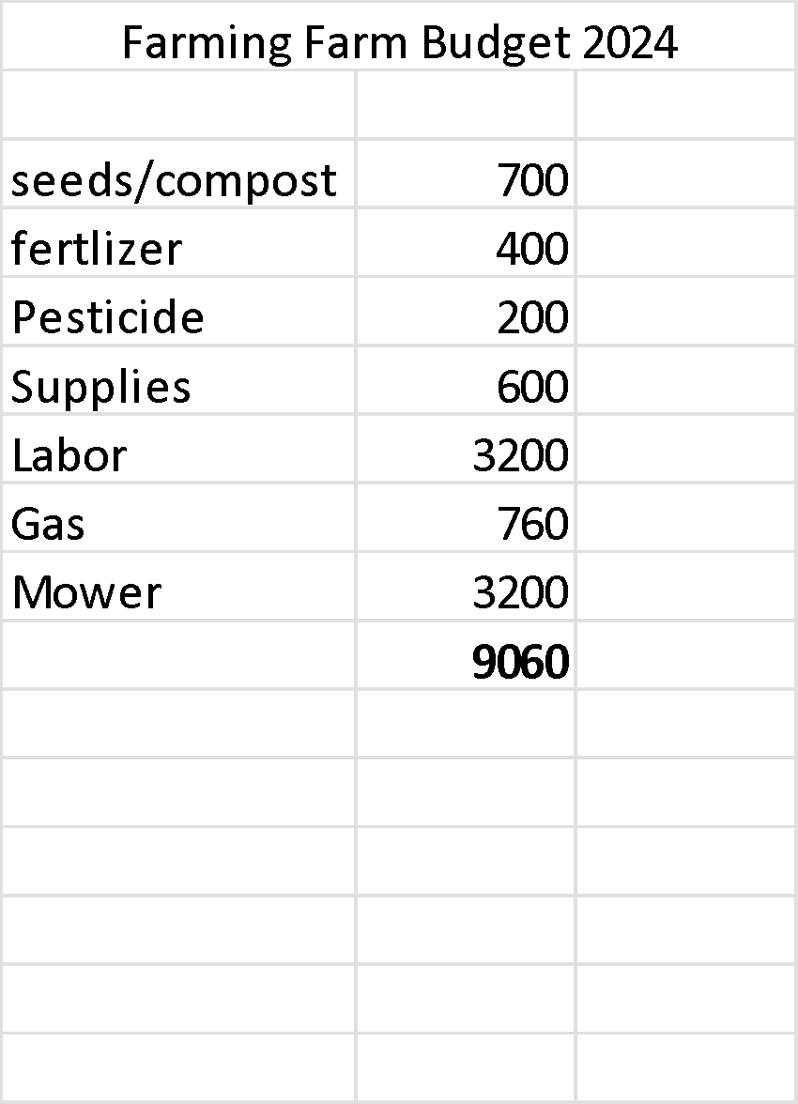
Key elements to grant writing: Budget

Slide 9
Key elements to grant writing: Cooperators
Definition:
Cooperators are organizations, entities, or individuals that actively collaborate with or contribute to the proposed project.
They play a hands-on role in the project's implementation and may provide resources, expertise, or other support.
Role in the Proposal:
Cooperators are typically mentioned in the project description or partnership section of the proposal.
Clearly outline the roles and responsibilities of each cooperator in the project.
Emphasize how their involvement enhances the project's effectiveness and impact.
Highlight any specific contributions they will make, such as financial support, in-kind services, or shared resources.

Slide 10
Key elements to grant writing: Letter of Support:
Definition:
A letter of support is a formal document written by a collaborating partner, endorsing and expressing commitment to the proposed project. It serves as tangible evidence of collaboration and community backing.
Role in the Proposal:
Letters of support are typically included in the appendices or attachments section of the proposal.
Each cooperator or collaborating partner may provide a separate letter of support.
The letter should be written by a key representative of the cooperating organization or individual.
It explicitly states the support, commitment, and benefits the cooperator sees in the project.
It may include details on how the cooperator's resources, expertise, or networks will enhance the success of the project..

Slide 11
Identify funding opportunities
Research funding sources and watch when they are open
Government
Minnesota Department of Agriculture - https://www.mda.state.mn.us/funding
Private Organizations
Mill City farmer's market - https://millcityfarmersmarket.org/grants/#next-stage-grant
Businesses
Compeer financial - https://www.compeer.com/investing-in-rural-communities/giving-back/grants/beginning-with-compeer
Lakewinds Coop - https://www.lakewinds.coop/loff-grant-application/
Individuals
Notes:
Before objectives, ask farmers to go through their business plans - a day before
How many have changed their values___________ and goals _________Objectives 1-4 (510- 530pm)
Financial, cultural, social (family, friends)

Slide 12
Lakewinds Organic Field Fund
Lakewinds Grant writing exercise https://www.lakewinds.coop/loff-grant-application/

Slide 13
Questions
Comments

